Slide 1
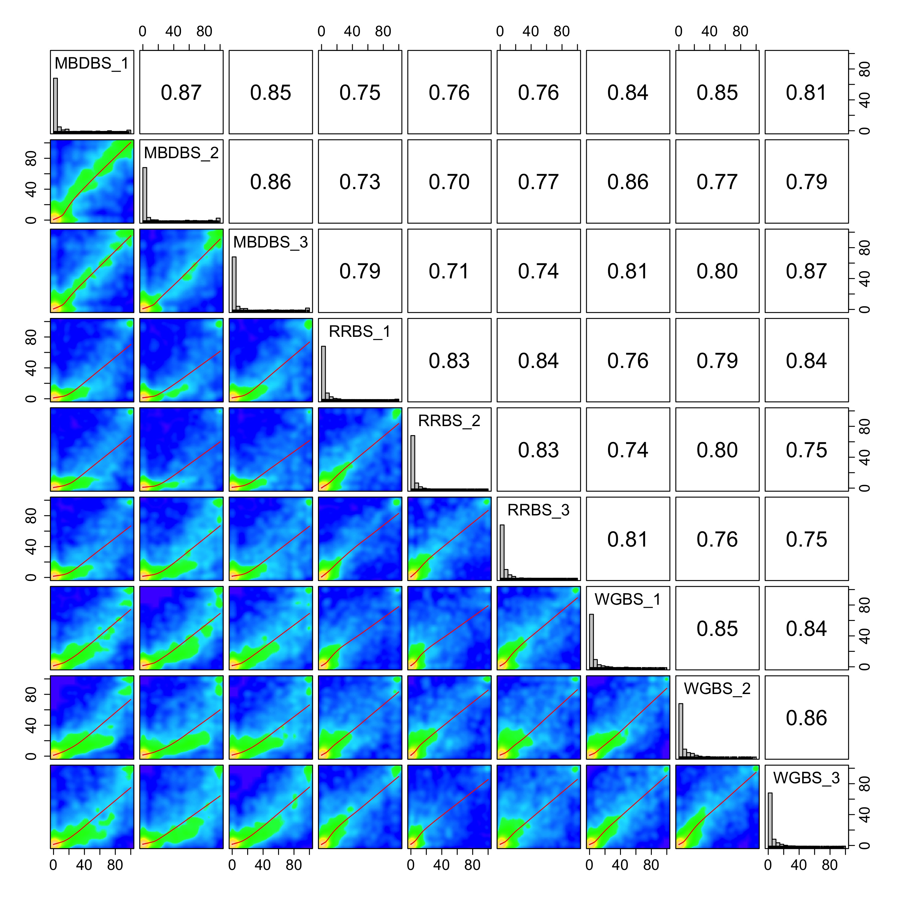
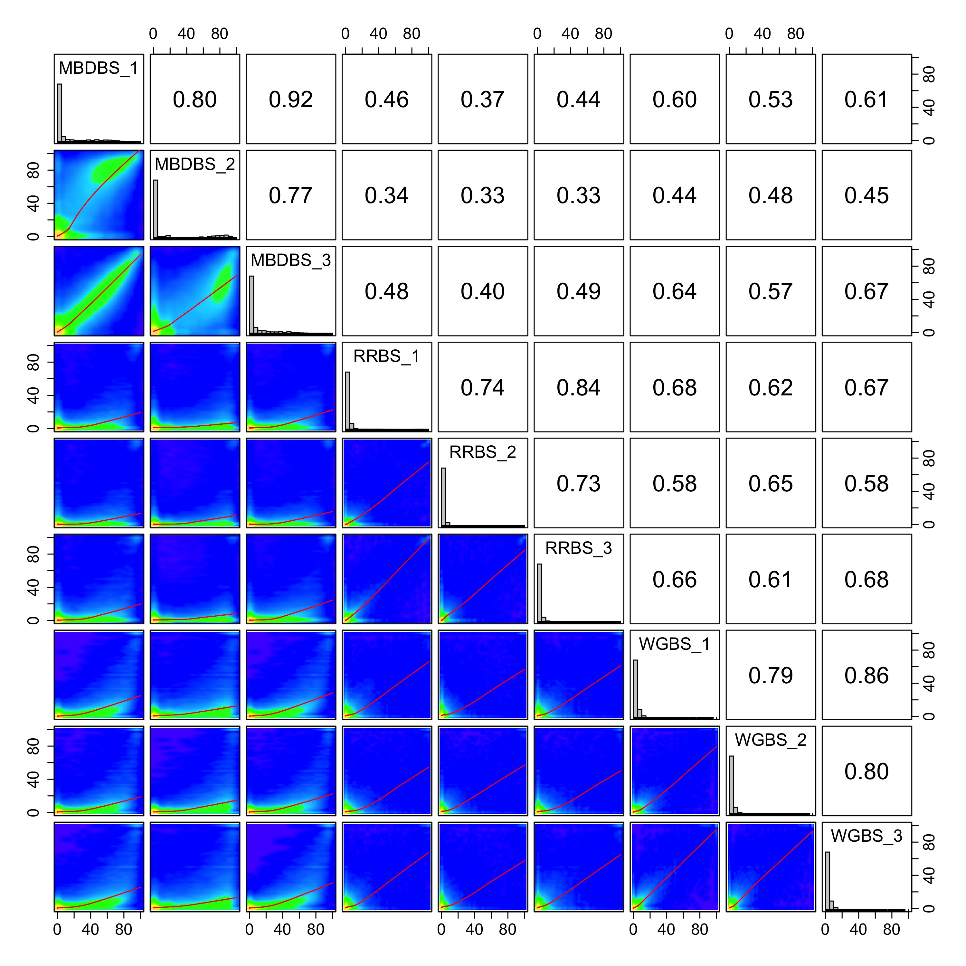
A
M. capitata
B
P. acuta
% methylation
% methylation
% methylation
% methylation

Slide 2
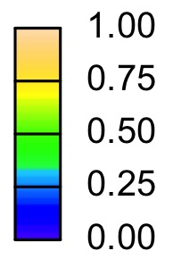
CpG base
Pearson
correlation

